Slide 1



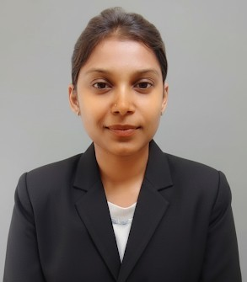
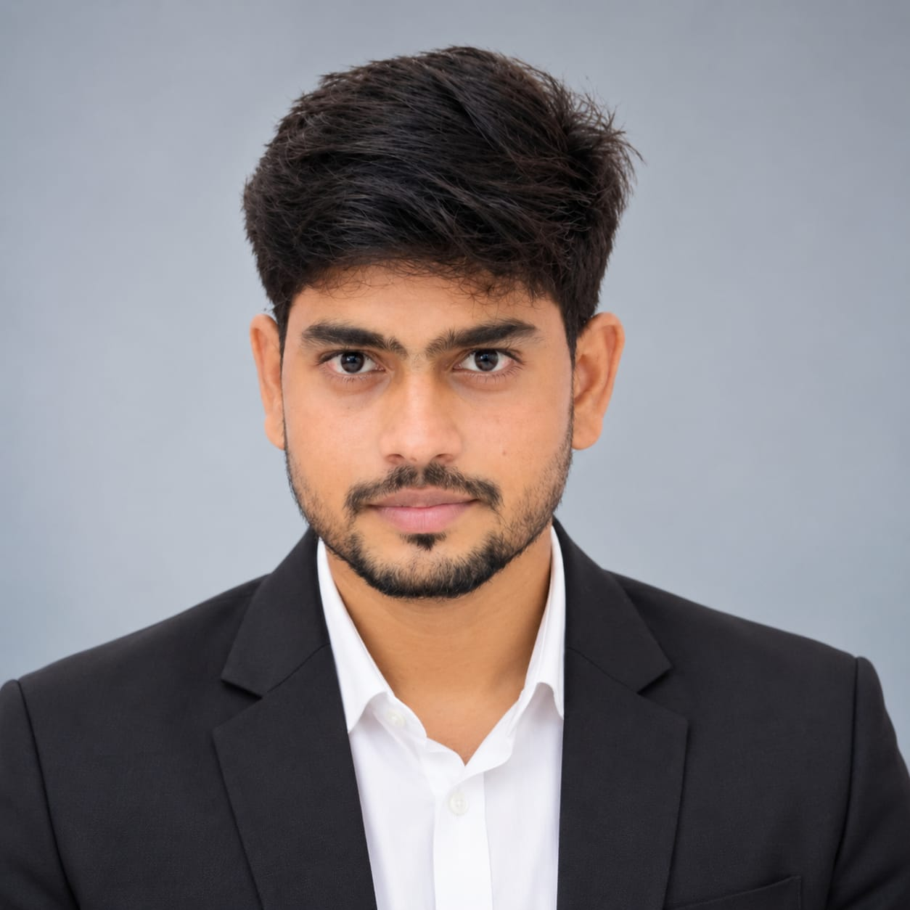
PS 01 • MAKING HEALTHCARE ACCESSIBLE & INTELLIGENT
github.com/suyash-rgb/AarogyaMitra
hf.co/TheUsurper09/aarogyamitra-qwen35-2b-gguf
AarogyaMitra
PROJECT LEADERSHIP • 3-MEMBER SQUAD
Intelligent Multilingual Edge-AI for Rural & Tier-2/3 Clinical Triage Navigation
Qwen 3.5 2B SFT GGUF • 2.8 GB RAM Budget
22 Indic Languages + Code-Mixed Hinglish
Deterministic Emergency 108 Red-Flag Bypass
TEAM LEAD • SYSTEM ARCHITECT & AI ENGINEER
AI SAFETY & GUARDRAILS ENGINEER
FRONT-END & PWA SIMULATION ENGINEER
Suyash Baoney
Poonam Patidar
Priyanshu Kumar
100% Offline Edge Deployable • Zero Cloud GPU Required
MCA-3rd Sem
[MCA-3rd Sem
MCA-3rd Sem
suyashbaoney58@gmail.com
poonampatidar0755@gmail.com
priyanshu74164@gmail.com

Slide 2



CONTEXT & SYSTEMIC CHALLENGES
The Healthcare Access Crisis in Bharat
Specialist Shortfall
Indic Language Barrier
Physical Document Lock
80% specialist vacancy at CHCs forcing hours of rural travel for primary consultations.
Cloud LLMs fail on Hinglish scripts and hallucinate clinical advice due to token splits.
Diagnostics remain trapped in blurry mobile camera photos and handwritten scripts from doctors.
80% CHC VACANCY
TOKEN FRAGMENTATION
NON-STANDARD FORMATS
The Bharat Opportunity: 425M+ Rural WhatsApp Users
COMMODITY CPU ONLY
Patients demand zero-cost navigation on commodity edge hardware without high-end cloud GPUs.

Slide 3
SYSTEM ARCHITECTURE PILLARS
Proposed Solution: AarogyaMitra
Lightweight, privacy-first clinical triage operating within a lean ~2.8 GB RAM footprint on commodity CPUs.
1
Clinical Triage Engine
2
Indic Localization
3
Multimodal Intake
Fine-tuned Qwen 3.5 2B enforcing structured risk staging and red-flag escalation.
Native support across 22 Eighth Schedule languages and Romanized Hinglish.
Deterministic routing of PDF lab panels and handwritten outpatient scripts.
Target: SFT Clinical Dialogues
Stack: IndicLID + IndicTrans2
Pipeline: PyMuPDF + mmproj VLM
EXECUTION PHASES:
Phase 1 (Active)
Text clinical triage, Hinglish translation & Laya routing
Phase 2 (Roadmap)
Hybrid lab PDF extraction + Doctor Rx vision LoRA

Slide 4
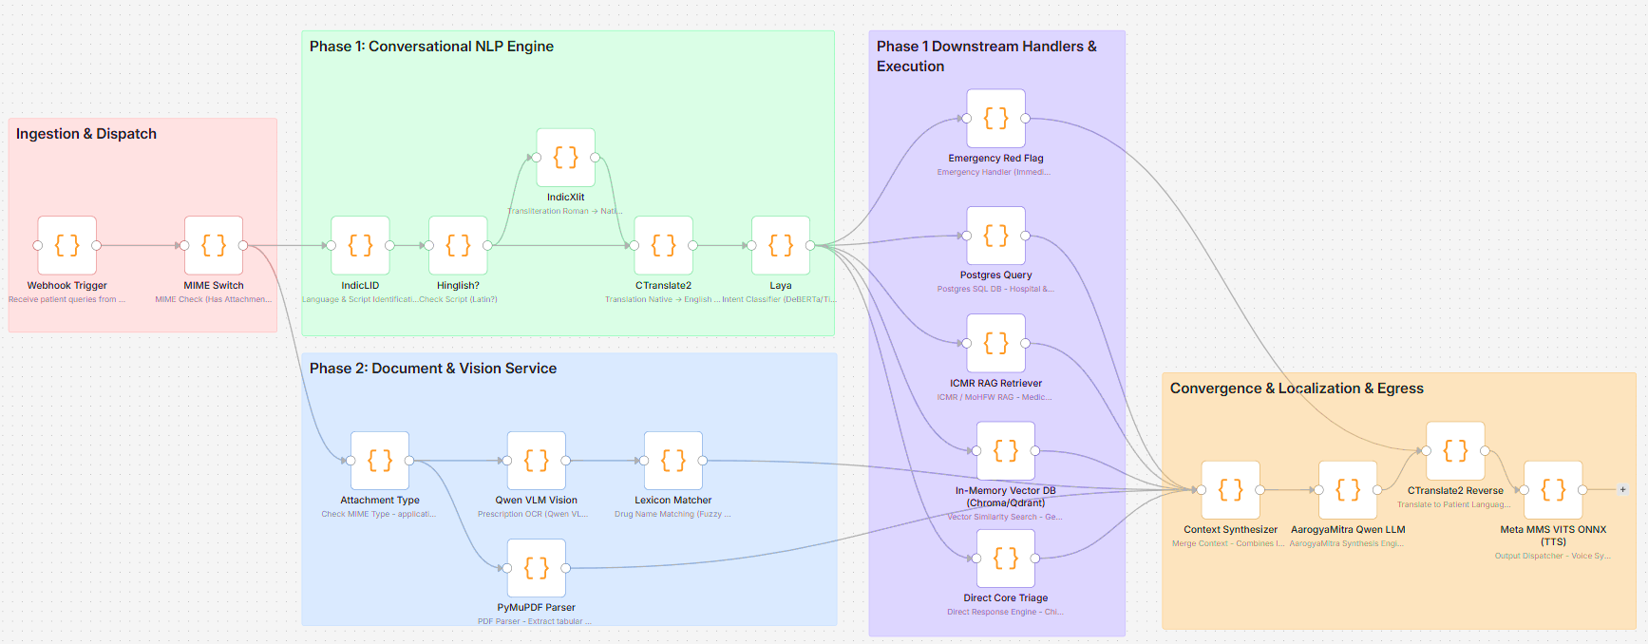





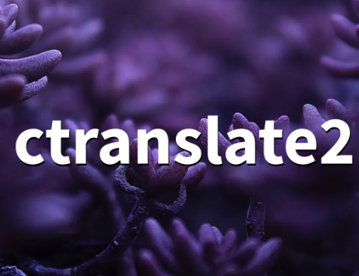









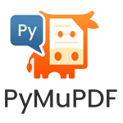

PIPELINE CANVAS
System Architecture

Slide 5

TECHNICAL FEASIBILITY & TOOLKIT
System Technology Stack & Edge Engines
Fully decoupled, zero-cloud dependency stack optimized for 4GB RAM commodity hardware.
Client & API Gateway
AI Core & Inference (Edge)
Indic NLP & Multilingual Voice
Database & Storage Layer
React
Webhook WhatsApp UI simulation and interactive testing dashboard.
Qwen 3.5 2B (GGUF Q4_K_M)
Quantized LLM served via local llama.cpp (<1.31 GB footprint).
IndicLID & IndicXlit
Script detection and Romanized Hinglish to Native transliteration.
Qdrant
High-performance Vector Database for ICMR clinical RAG & semantic search.
React Native (Expo)
Lightweight, cross-platform PWA & mobile client.
Laya AI Classifier
Custom high-speed 6-class intent & routing engine (<40ms latency).
CTranslate2 (INT8) / NLLB-200
Accelerated neural translation engine across 22 Indic languages.
PostgreSQL + SQLAlchemy
Relational store for health facilities & scheme registries.
FastAPI + Uvicorn
High-throughput async REST API & WebSocket gateway.
Qwen VLM & EasyOCR
Edge vision pipeline for prescription & pathology OCR parsing.
Meta MMS VITS / Piper
Zero-latency local speech synthesis (TTS) via ONNX C++.
Valkey / Cachetools
In-memory caching for zero-latency frequent query lookups.
100% Offline Edge Deployable • Zero Cloud GPU Required • RAM Footprint ≤ 2.8 GB

Slide 6
ENGINEERING DEEP-DIVE
Two-Track Ingestion Architecture
Track A: Text & Voice Core
Track B: Document & Vision Bypass
Indic Normalization Pipeline
Deterministic Laya Bypass
IndicLID identifies regional scripts; IndicXlit converts Latin Hinglish before IndicTrans2/ translation.
MIME presence automatically circumvents text intent classification, saving 100% token overhead.
ModernBERT Laya Router
Pathology Parser (PDF)
421M non-autoregressive decision model routing queries in <40ms across 6 distinct category classes.
PyMuPDF deterministic table extraction for CBC, LFT, and metabolic panels in <10ms.
Deterministic Red-Flag Exit
Prescription Vision LoRA
Critical emergencies instantly trigger 108/102 helpline links without model hallucination risk.
Qwen mmproj vision model paired with 10,000+ Indian generic drug lexicon fuzzy matcher.
Stack: ModernBERT + IndicTrans2 + ONNX int8
Stack: PyMuPDF + Qwen VLM mmproj + FuzzyRx
Phase 1: Track A Active • Phase 2: Track B Integration

Slide 7
QUANTIZATION & EFFICIENCY
Model Training & Edge Hardware Budget
AarogyaMitra Clinical SFT
Edge Hardware Budget (Single 4-Core CPU VM)
Validation Loss Floor
Clinical Perplexity
MODULE | PRECISION | RAM | SPEED
AarogyaMitra Core | GGUF Q4_K_M | ~1.31 GB | 18–25 tok/s
Laya Router | ModernBERT int8 | ~0.45 GB | ~35 ms
Indic Translation | IndicTrans2 int8 | ~0.40 GB | ~250 ms
Vision Projector | F16-mmproj | ~0.67 GB | On-demand
0.6385
1.894
Parameter-Efficient LoRA fine-tuning on Qwen 3.5 2B via Unsloth. Enforces strict clinical triage protocol without catastrophic forgetting.
Artifact: GGUF Q4_K_M (~1.31 GB) on Hugging Face
Total Combined Memory:
≤ 2.8 GB RAM (Zero GPU)
Fits entirely within standard 4GB commodity VM limits ($5/month hardware target).
Full Determinism • Zero Cloud Dependence

Slide 8
HACKATHON EXECUTION SCOPE
Working Prototype in 3 Hours
Live Local llama.cpp Server
READY
Serves quantized Qwen 3.5 2B GGUF with low-temperature clinical sampling parameters.
Async FastAPI Gateway
READY
Dual-track endpoint handling text queries and file-attachment payloads with automatic dispatch.
Hybrid PIN Code & Intent Routing
READY
Regex-based Indian PIN extraction for hospital lookups plus neural symptom triage routing.
Hinglish Code-Mixed Normalization
READY
Ingests queries like "3 din se tez bukhar aur vomiting" into standardized clinical triage.
Interactive Verification UI
READY
Live dashboard demonstrating latency logs, track execution paths, and triage risk tiers.
Complete functional stack deployed locally.

Slide 9



SAFETY BOUNDARIES & VISION
Clinical Safety & Public Health Vision
Emergency Short-Circuit
Triage vs. Diagnosis
ABDM & UHI Alignment
Chest pain and respiratory distress bypass generative reasoning, immediately triggering 108 helpline dispatch.
Designed strictly as a navigation aid directing patients to Home Care, PHC, or Tertiary Care without rogue prescriptions.
Total Ayushman Bharat and UHI guidelines compliance.
Zero Cloud Dependency • 100% Offline Edge Deployable
huggingface.co/TheUsurper09/aarogyamitra-qwen35-2b-gguf

